Slide 1


Day 08
contact@anubhavtrainings.com
ABAP RESTFUL APPLICATION PROGRAMMING

Slide 2

Agenda – Day 08
What is git and git HUB
Working with git
ABAP git scenario
Service Consumption Model
Describing the Concept of Custom Entity
Why we use Custom Entity
Implement Custom Entity
Create Class for Custom Entity
Test Custom Entity
Working with Analytic List Page
Working with OVP Application
Cross App navigation from OVP

Slide 3

What is Git ?
Git is a free and open source distributed version control system designed to handle everything from small to very large projects with speed and efficiency.
Git is easy to learn and has a tiny footprint with lightning fast performance. It outclasses SCM tools like Subversion, CVS, Perforce, and ClearCase with features like cheap local branching, convenient staging areas, and multiple workflows.

Slide 4


Git and Git HUB
The git is a distributed repository management system and git hub is a repository which stores our code online.
Install git in our system from here check via command git --help
Mike
(Fiori Developer)
Julie
(Fiori Developer)
VS Code
BAS
git clone <REPO>
project
project
git init
git add . / git add <filename>
git commit –m <change text>
git push
git add . / git add <filename>
git commit –m <change text>
git push
02f35e2
Local git repository
Local git repository
GitHUB
REMOTE Repository
project
ab43f94
project
branch
master
git reset <commitid>

Slide 5
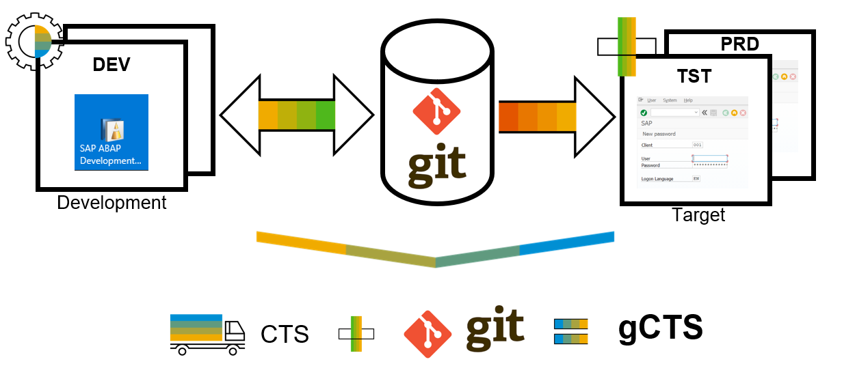
What is ABAP Git ?
abapGit is a tool to import and export code between ABAP systems. If a developer has a developer key to the system, the developer can perform these actions already. abapGit enables the developer to do mass export/changes/imports but not more than already possible to do manually.
Running automated security checks on the abapGit code will by design give a lot of errors, as abapGit will import, overwrite and change ABAP artifacts in the system in ways that might not be intended. Always review all code in remote repositories before importing to the target system, this is possible because abapGit is plain text unlike traditional transport files.
That being said, abapGit is used by mutiple organizations, all abapGit changes are reviewed via pull requests. And all 100+ repository watchers are automatically notified for every change to the code base, so potentially all changes are looked at by more people than tradtional enterprise products.

Slide 6
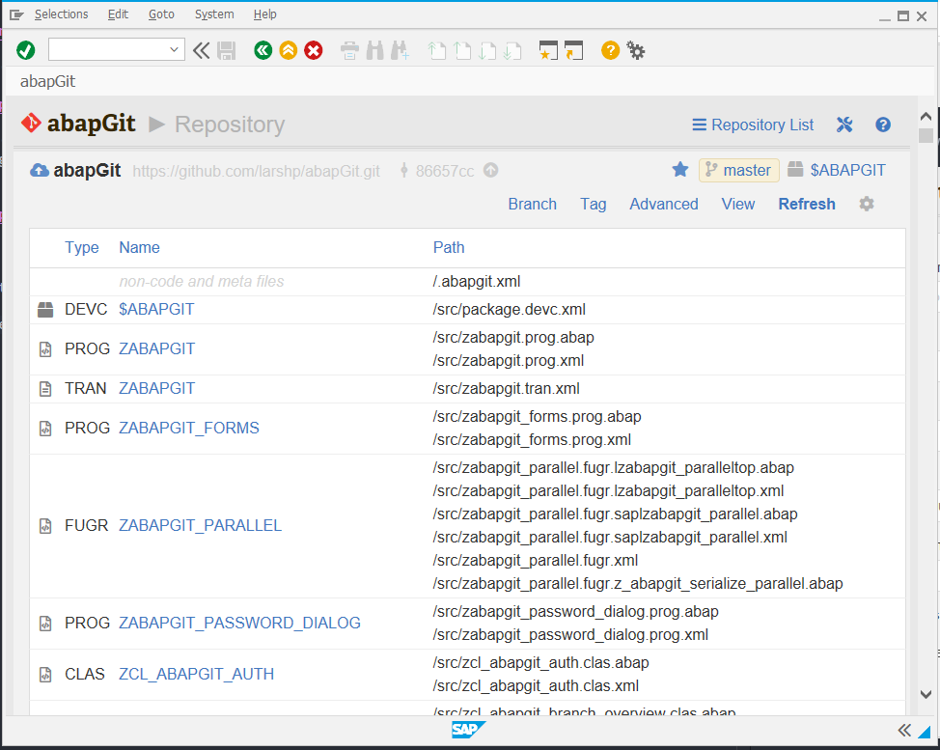
ABAP Git
It is a community effort to support the project, recommend watching the project to get a feeling about issue resolution. Everyone can suggest changes to abapGit via pull requests.

Slide 7
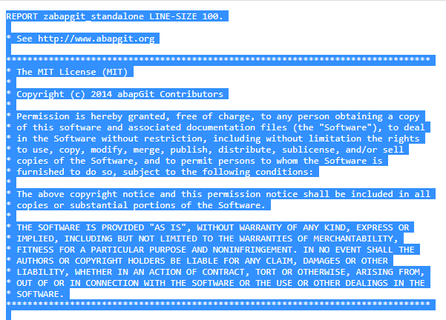
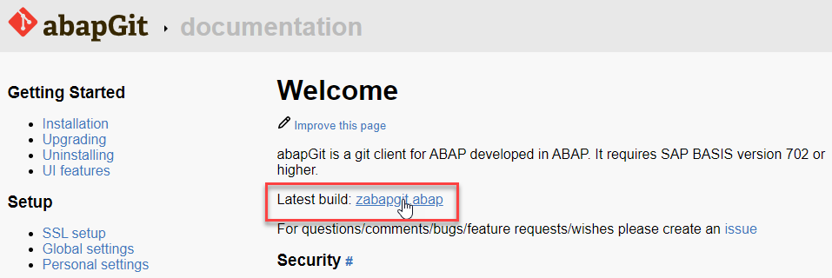
ABAP Git Integration
Step 1. Go to https://docs.abapgit.org/ in browser and click on Latest Build.
Step 2. Copy this Code.

Slide 8
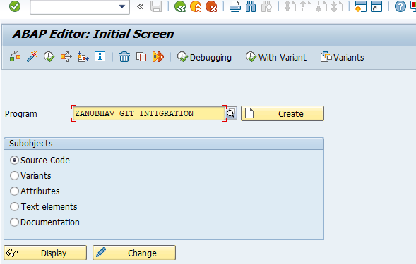
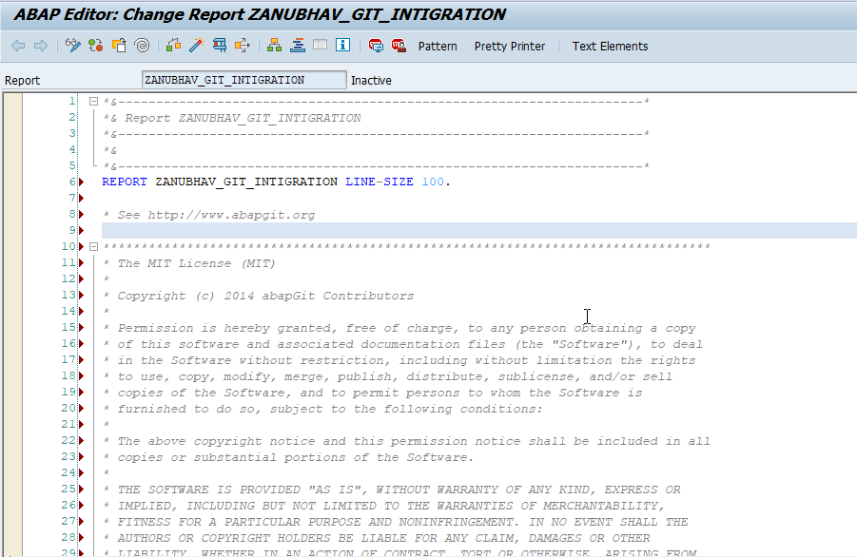
ABAP Git Integration
Step 3. Open SAP Gui Go to T-Code SE38 for Building Report, give any name to report and click on create.
Step 4. Paste the Copied Copy in this report.

Slide 9
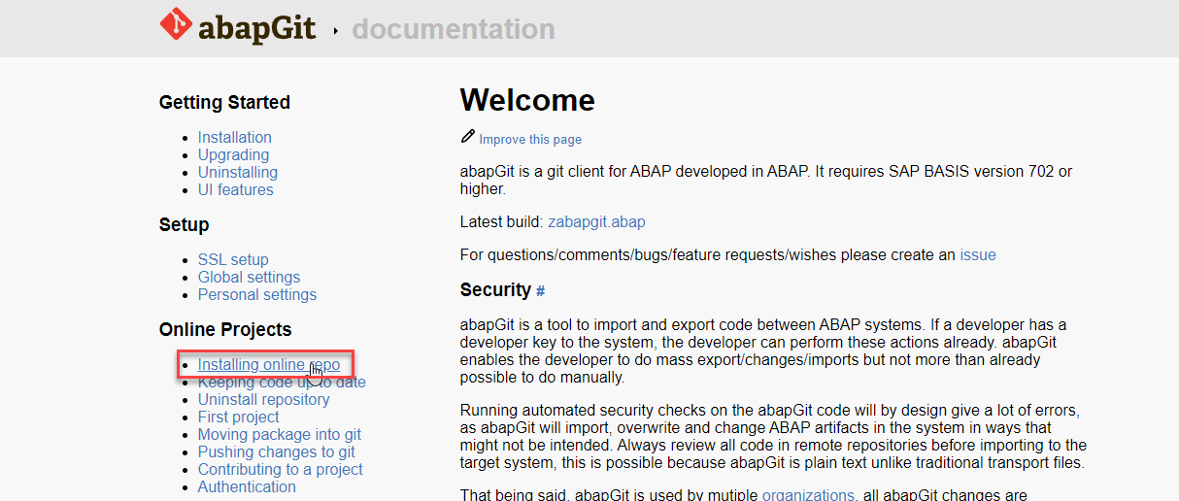
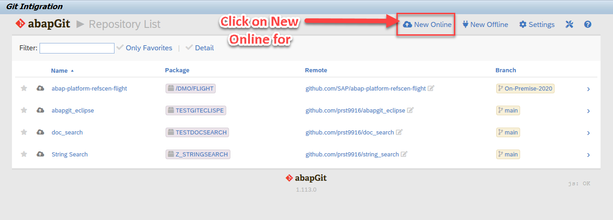
ABAP Git Integration
Step 5. After the Execution, abapGit Screen
Step 6. Go back to Bowser side and click on Installing Online Repo

Slide 10
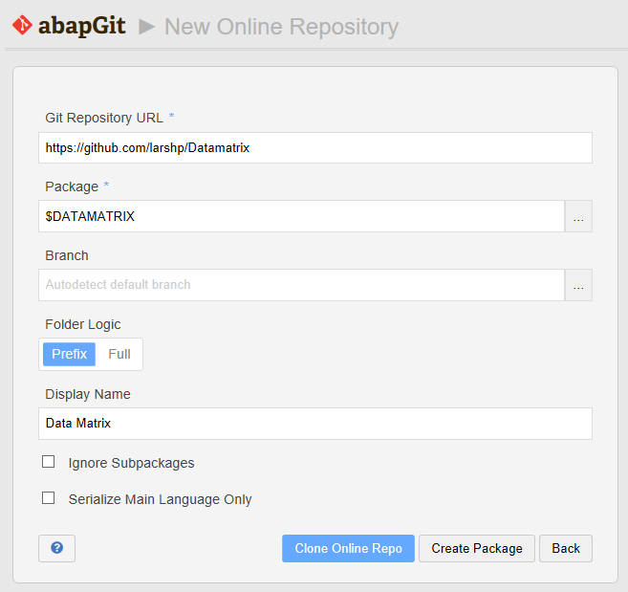
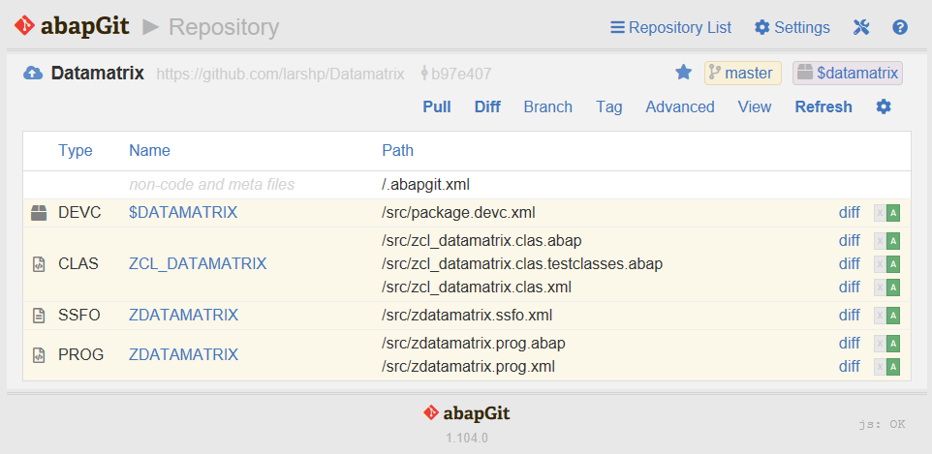
ABAP Git Integration
Step 7. Enter the url for the Github project, eg https://github.com/larshp/Datamatrix along with a package name, eg. $DATAMATRIX. If the package does not exist yet, it will be created automatically when pulling. Alternatively, you can select “Create Package” to create the package manually with your own settings.
Step 8.Select “Clone Online Repo”
Select “Pull” to copy all objects from the Git repository into the SAP system

Slide 11
Introduction – Flexible Service Consumption
For a more flexible service consumption, every transactional business object is projected into a service specific context. In other words, only those elements of the data model and those behavior characteristics and operations that are needed in the relevant business service context are exposed for the service.
By means of projections, you can expose one BO in different business contexts by using different BO subsets. The general business logic is defined in the BO whereas the BO projection adopts a subset of the business logic.
A layering with projections enables robust application programming. You can change or enhance the BO without changing the exposed service as the scope of the service is defined in the projection layer. Enhancing the business object with additional structure or behavior does not have any effect on the resulting service.

Slide 12
Introduction to Scenario & Flow
we want to replace the travel agencies data of our managed travel app with the results of the remote OData service that provides different set of travel agencies from other system altogether. For this use case, we shall leverage the concept of a custom entity. In contrast to "normal" CDS views that read data from the database tables or other CDS views, the so called custom entities act as a wrapper for a code based implementation that provides the data instead. This use case involves following steps.
Creating the Service Consumption Model
Defining the Custom CDS Entity
Create a class that implements the query for the custom entity
Agency
Custom Entity
Implanting class
Fiori App
OData
CDS
Agency
/DMO/AGENCY

Slide 13
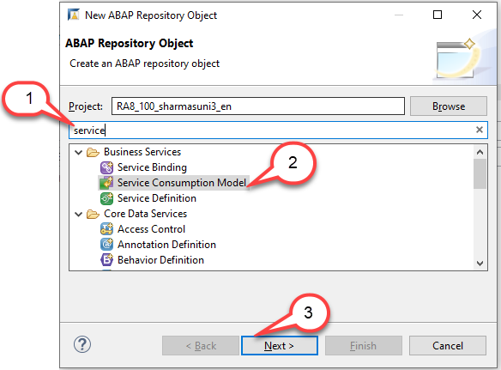
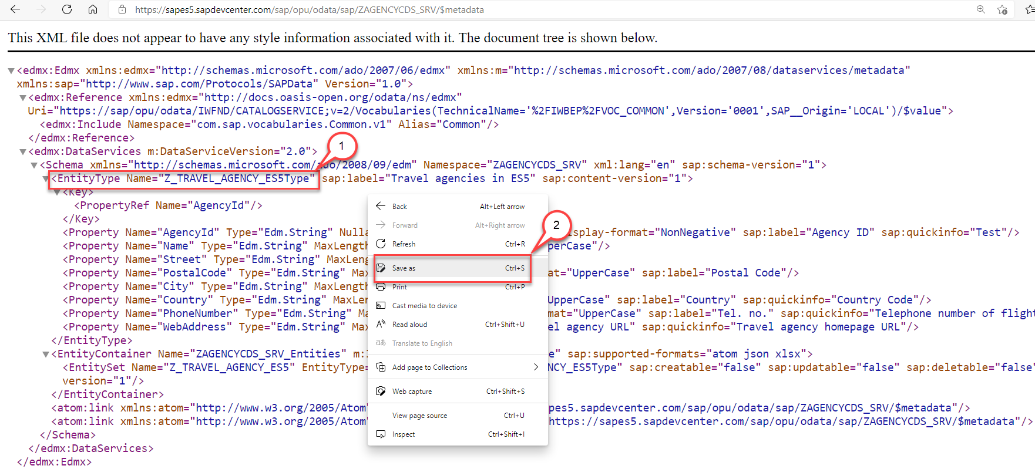
Creating the Service Consumption Model
Create an OData service consumption model in an SAP Business Technology Platform, ABAP Environment instance. In a second instance, prepare it for consumption.
Step1: Download $metadata file https://sapes5.sapdevcenter.com/sap/opu/odata/sap/ZAGENCYCDS_SRV/$metadata
Step2: Create the Service Consumption Model

Slide 14
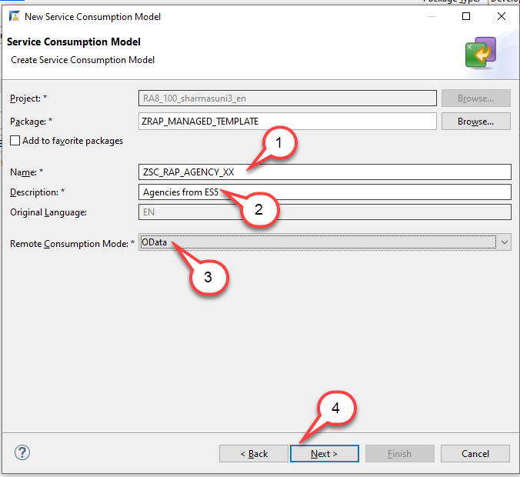
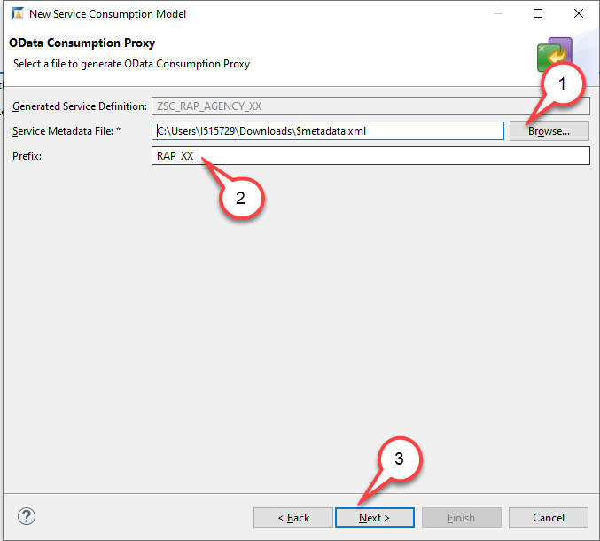
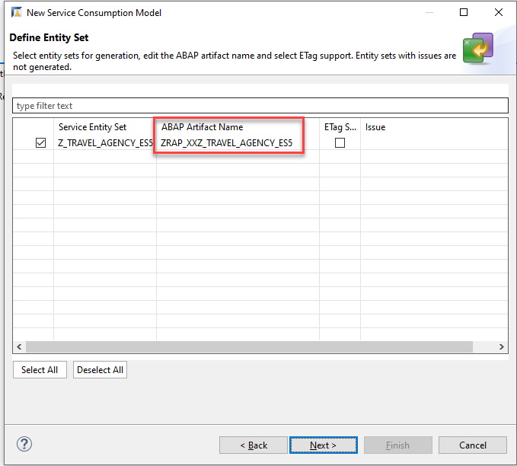
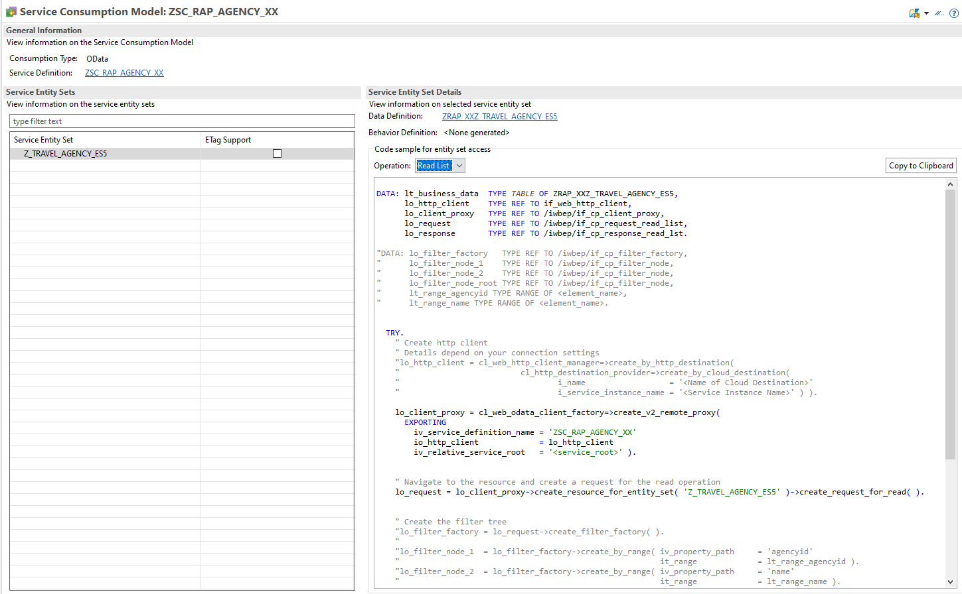
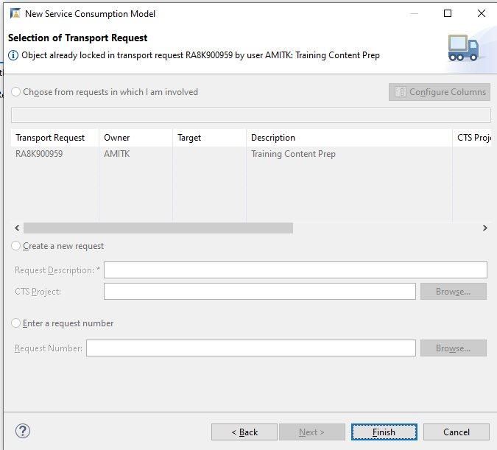
Creating the Service Consumption Model
Steps for Creating Service Consumption Model Click Next to Each step and finish.
For each operation (Read List, Read, Create, Update and Delete) some sample code has been created that you can use when you want to call the OData Service with one of these operations. Since we want to retrieve a list of Agencies, we will select the operation Read List and use this code.

Slide 15
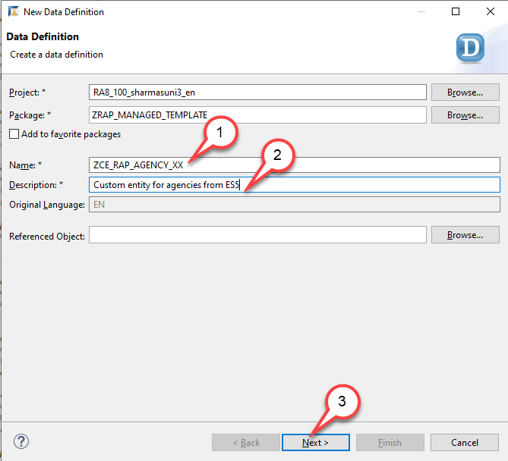
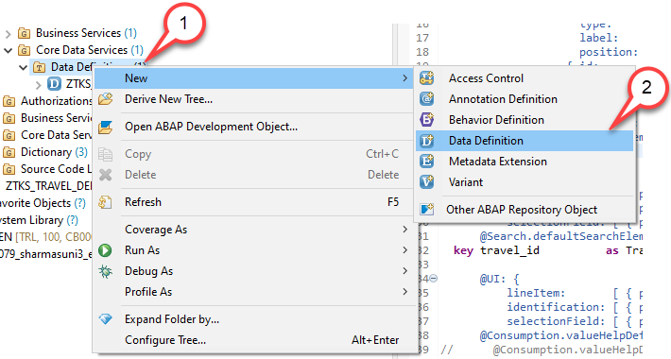
Defining the Custom CDS Entity
The custom entity must be created manually with similar syntax as the abstract entity that has been created when we have created our service consumption model. To leverage the remote OData service in our application we have thus to perform two steps: o We must create a custom entity. o We must create a class that implements the query for the custom entity. Create a custom entity
1. Right-click on the folder Data Definition and select New Data Definition.
2. Start with creating a new data definition ZCE_RAP_AGENCY_XX using the template for a Custom Entity.
The New Data Definition dialogue opens…

Slide 16
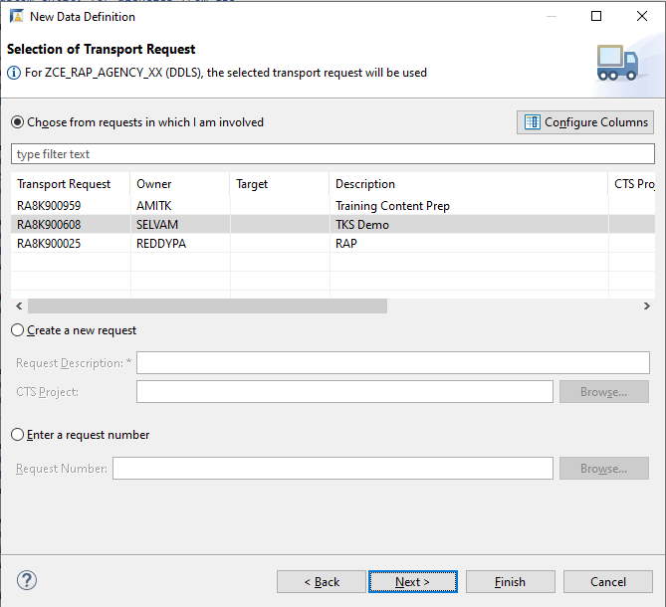
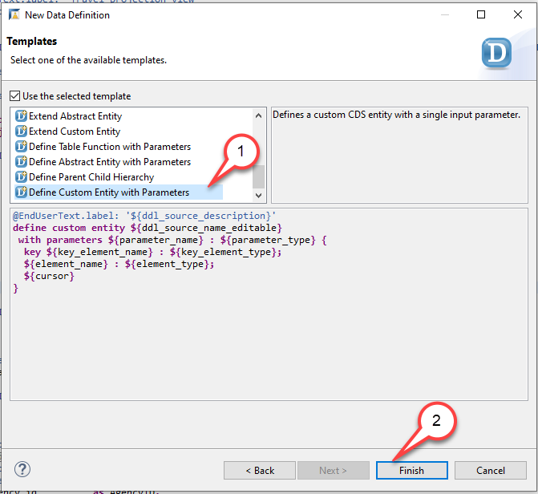
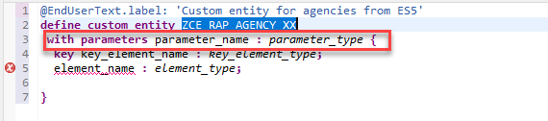
Creating Custom Entity
Press Next. Do NOT press Finish. Caution If you would press Finish instead of Next the wizard will use the template that was used the last time when this wizard was used by the developer.
4. Select the template Define Custom Entity with Parameters. Press Finish…
5. Edit the source code of the custom entity ZCE_RAP_AGENCY_XX Remove the statement with parameters parameter_name : parameter_type

Slide 17
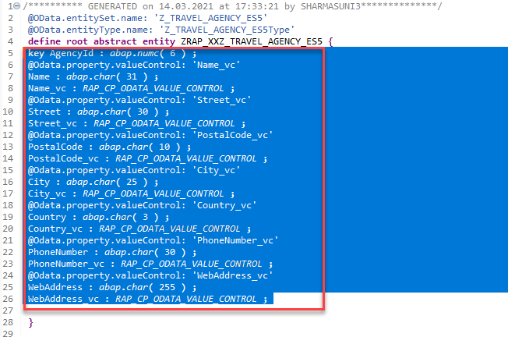
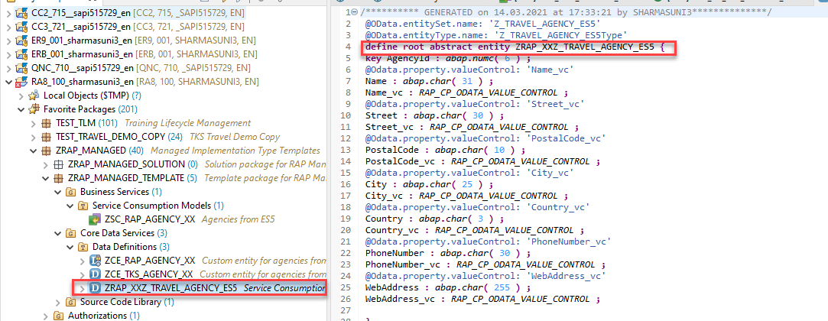
Creating Custom Entity
6. Now, open the abstract entity you created in Service Consumption Model in the source code editor Navigate to the abstract entity ZRAP_XXZ_TRAVEL_AGENCY_ES5 in the Project Explorer Double click on it to open the source code editor
7. Copy field list from abstract entity to custom entity Copy the field list from the abstract entity and paste it between the curly brackets as the new field list of the custom entity, thereby replacing the field list provided by the code template. You can make use of the Source Code Formatter (SHIFT+F1) to format the source code.

Slide 18
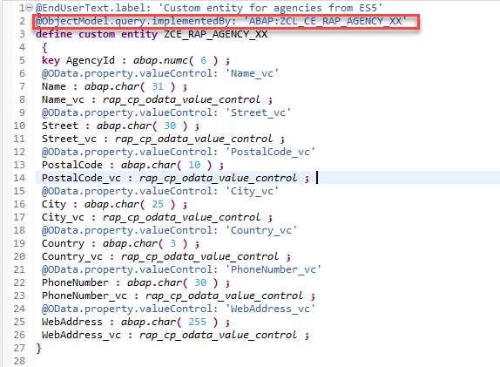
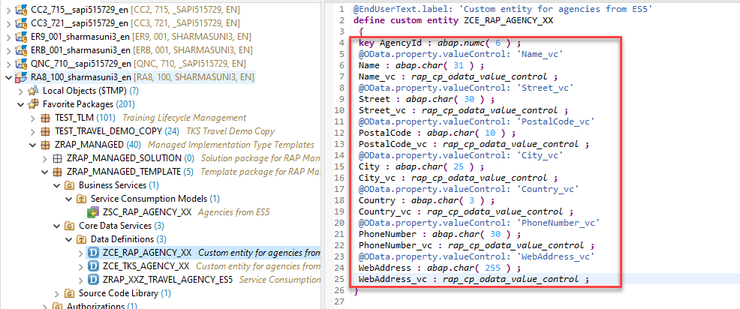
Creating Custom Entity
8.Paste the code in our Custom Entity
9. Add the annotation @ObjectModel.Query.ImplementedBy
to the DDL source code @ObjectModel.query.implementedBy: 'ABAP:ZCL_CE_RAP_AGENCY_XX' and activate your changes.

Slide 19
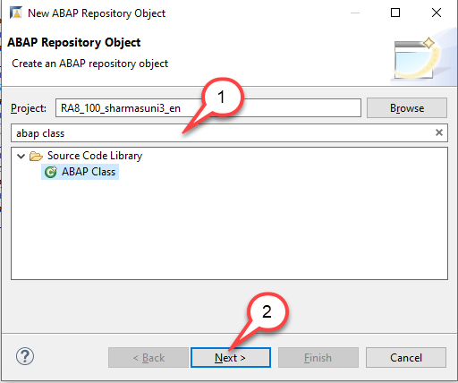
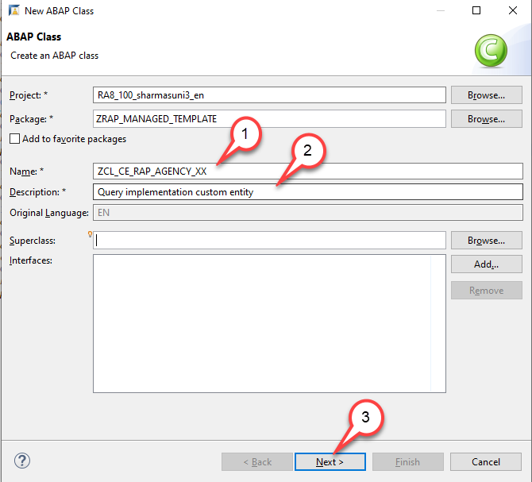
Create a class that implements the query for the custom entity
To be able to use our class as a query implementation class of our custom entity our class must implement the interface if_rap_query_provider. We will thus add this interface to it.
1.Search for ABAP class and press Next
2.Create a new ABAP class ZCL_CE_RAP_AGENCY_XX for custom entity ZCE_RAP_AGENCY_XX. The New Data Definition dialogue opens

Slide 20
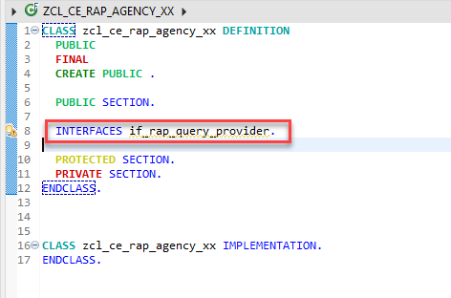
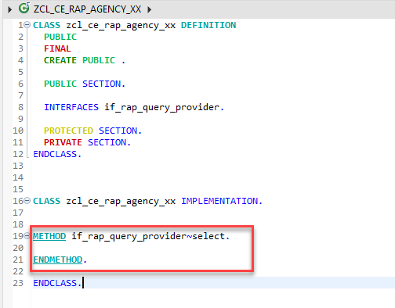
Class Implementation
3. Add interface IF_RAP_QUERY_PROVIDER to the query implementation class ZCL_CE_RAP_AGENCY_XX Add the following statement in the public section INTERFACES if_rap_query_provider.
4. Add an implementation for the method if_rap_query_provider~select.
Code here for Method

Slide 21
Something Important
Implement the method if_rap_query_provider~select. Within the select() method, we can retrieve the details of the incoming OData call using the object io_request. Using the method get_paging() we can find out whether client side paging was requested with the incoming OData call. Using the method get_filter() we can retrieve the filter that was used by the incoming OData request and by calling the method ->get_as_ranges( ) provided by the filter object we can retrieve the filter as ranges. Using the methods is_data_requested( ) and is_total_numb_of_rec_requested( ) we are able to find out whether the incoming request requests that business data is returned and whether the request contains a $count.
Please note:
If business data is requested, It is mandatory to add the retrieved data via the method set_data() .
If in addition, the number of all entries of an entity is requested, the number of entities being returned must be set via the method set_total_number_of_records(). Copy and paste the coding below into the implementation of the method if_rap_query_provider~select.

Slide 22
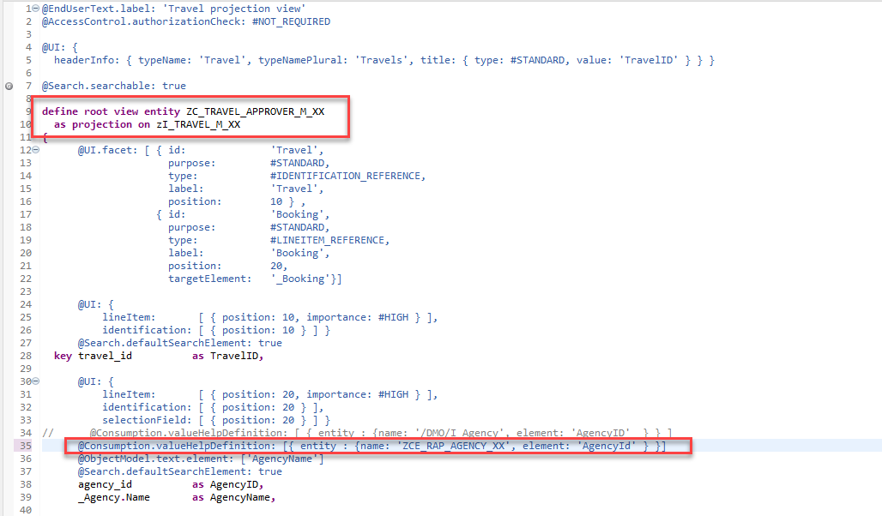
Test the Custom Entity in Projection CDS
You have implemented the query implementation class of the custom entity. As a result we can now enhance the implementation of our managed business object that we have created to use the custom entity as a value help Enhance the manage BO entity

Slide 23
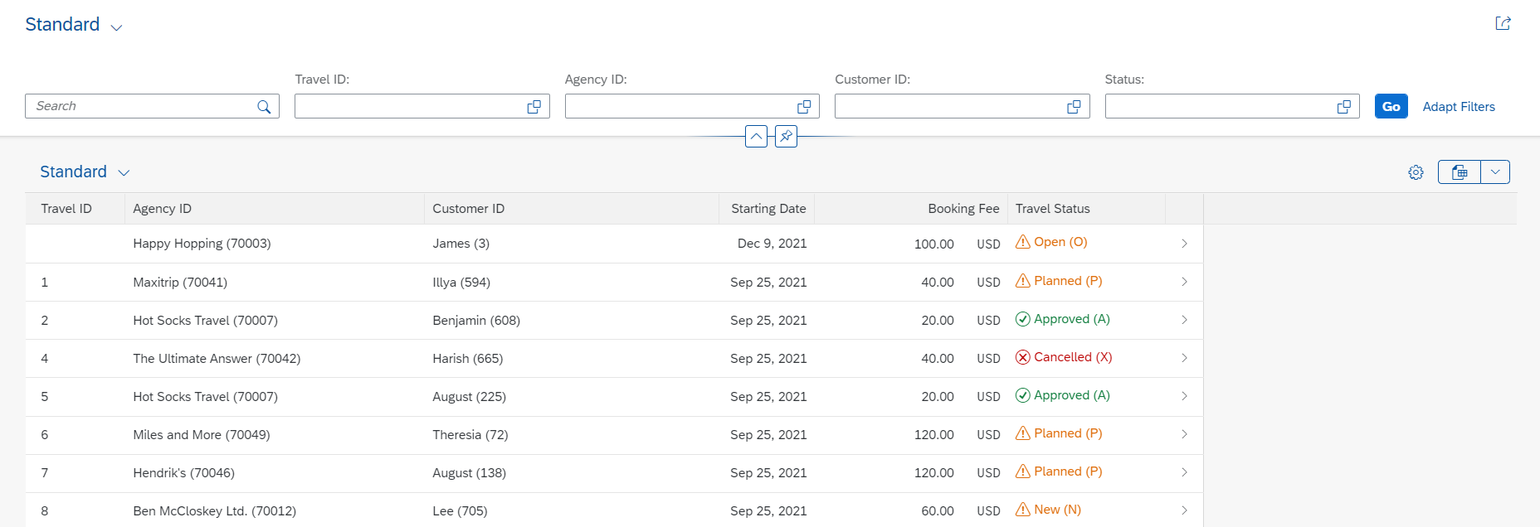
Enabling Status with Icon
A Status with icon provide more intuitive analysis of the data to the business user, using the criticality annotation available at the LineItem level, we can design and deliver best in class user experience with RAP and CDS entities.
Exercise - Solution

Slide 24
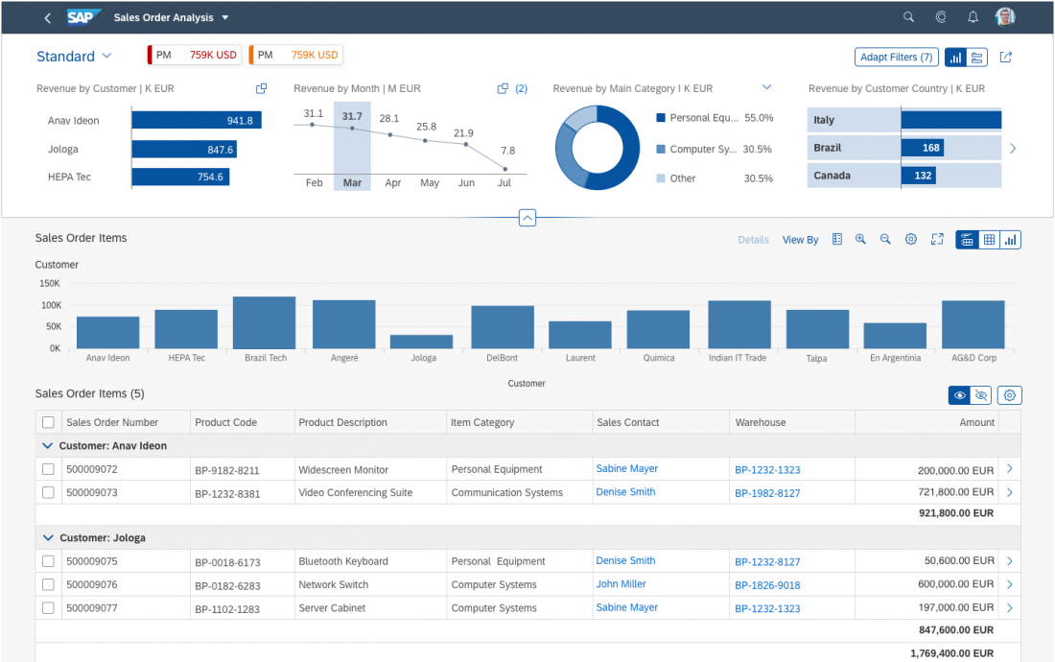
Working with Analytic List Page
The analytical list page (ALP) offers a unique way to analyze data step by step from different perspectives, to investigate a root cause through drilldown, and to act on transactional content. All this can be done seamlessly within one page.
The purpose of the analytical list page is to identify interesting areas within datasets or significant single instances using data visualization and business intelligence.
Visualizations help users to recognize facts and situations, and reduce the number of interaction steps needed to gain insights or to identify significant single instances. Chart visualization increases the joy of use, and enables users to spot relevant data more quickly.

Slide 25











Slide 26
When to use ALP
Users need to extract key information to understand the current situation or identify a root cause. The way the data is presented is crucial for giving them the insights they need to take the right action.
Users need a way to analyze data step by step from different perspectives, investigate a root cause through drilldown, and act on transactional content within one page.
In addition to the filtered dataset, users need to see the impact of their filter settings in a chart (visual filter).
Users need to switch between integrated chart and table views (hybrid view).
Users need to see the impact of their action on a global key performance indicator (KPI).
Users need to find and act on relevant items out of a large set of items by searching, filtering, sorting, grouping, drilling down, and slicing and dicing.

Slide 27
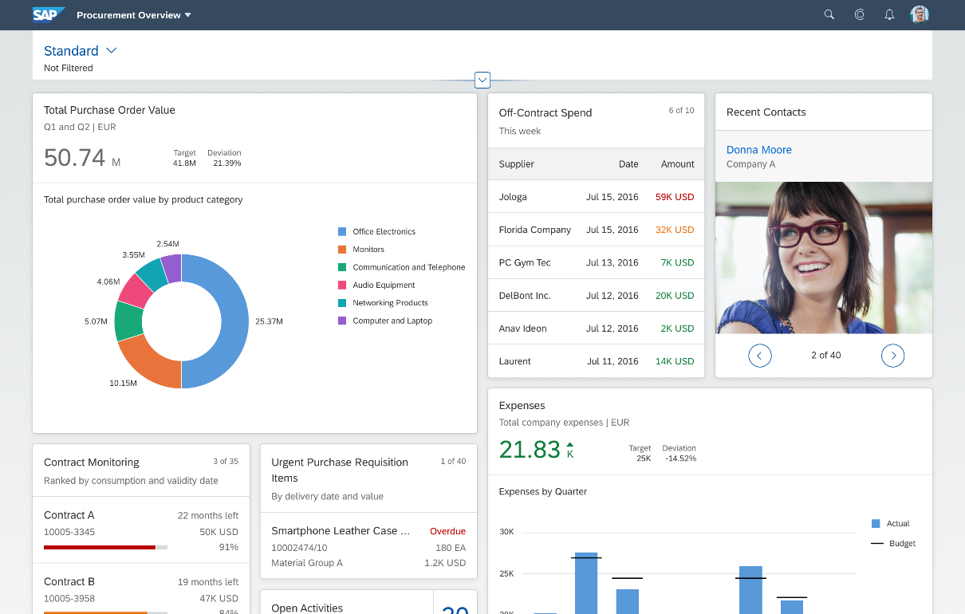
Working with Overview Page (OVP)
The overview page (OVP) is a data-driven SAP Fiori app type and floorplan that provides all the information a user needs in a single page, based on the user’s specific domain or role. It allows the user to focus on the most important tasks, and view, filter, and react to information quickly.
Each task or topic is represented by a card (or content container). The overview page acts as a UI framework for organizing multiple cards on a single page.
The overview page is based on SAP Fiori elements technology, and uses annotated views of app data, meaning that the app content can be tailored to the domain or role. Different types of card allow you to visualize information in an attractive and efficient way.

Slide 28
When to use OVP
You want to provide an entry-level view of content related to a specific domain or role.
Users needs to filter and react to information from at least two different applications to complete their role-specific tasks.
You want to offer different information formats (such as charts, lists, and tables) on a single page.
You plan to have at least three cards. These cards should not all be of the same type.

Slide 29

End of Day 08
Trainer: Anubhav Oberoy

Slide 30
Trainer: Anubhav Oberoy

Slide 31
THANK YOU
If you cannot do
great things, do small things in a great way.
Anubhav Oberoy
https://www.anubhavtrainings.com

Slide 32


We’re committed to empower you to be
Most Desirable Resource
through powerful training solutions.
We build the workforce of the future.
250+
Corporate Clients
30,000+
Learners Trained
25000+
Learners Placed
FREE WEBINARS
Sign up for free webinars with industry experts every fortnight!
Enroll Now!
Contact us today!
https://anubhavtrainings.com/

Slide 33




More from AnubhavTrainings.com

